Slide 1


FINAL REVIEW PRESENTATION – Batch 01
Food Expiry Detection
and Reminder System
SmartFood • AI-assisted food inventory and freshness tracking
S. Karunya | V. Abarna | M. Yogalakshmi
Guide: Ms. S. M. Sowmiya, Assistant Professor
Department of Artificial Intelligence and Machine Learning • VISTAS, Chennai
01

Slide 2
Project Overview
SmartFood helps users track packaged and fresh food, monitor remaining shelf life, and receive reminders before expiry.
Packaged food
Fresh food
Inventory & reminders
OCR reads printed expiry-related dates from a product label. The extracted date should be reviewed before saving.
Shelf-life estimates use food type and selected storage conditions when a printed expiry date is unavailable.
A central inventory, configurable reminder timing, and notification preferences help users prioritize food.
02

Slide 3
Problem Statement
• People may forget food items stored in refrigerators, cupboards, or pantry shelves.
• Packaged food dates are printed in different formats and may require manual checking.
• Fresh fruits and vegetables often do not carry a clear printed expiry date.
• Manual inventory updates take time and can lead to missed reminders.
• Without a single view of food items and their remaining shelf life, items may be wasted.
Need for SmartFood
A simple system that combines date scanning, shelf-life estimation, inventory tracking, and configurable reminders.
03

Slide 4
Objectives
01 Automate date capture
02 Estimate shelf life
Use OCR to extract printed date information from packaged food labels.
Use food category and storage condition for indicative estimates when no readable date is available.
03 Manage inventory
04 Send reminders
Keep food items organized and make it easier to review their status.
Allow users to configure how many days before expiry they want to be reminded.
04

Slide 5
Existing System vs Proposed System
Manual tracking
SmartFood approach
• Users check printed dates one by one
• Fresh-food shelf life is difficult to track consistently
• Reminders depend on memory or separate tools
• Inventory information can become outdated
• OCR-assisted printed-date extraction
• Shelf-life estimate based on food type and storage condition
• Centralized food inventory and history
• Configurable expiry alerts and notification preferences
05

Slide 6
Literature Survey
S.NO | PAPER TITLE | AUTHOR | PROBLEM CONCERNED | CONCEPT | LIMITATIONS
1 | A Mobile Approach to Food Expiration Date Determination Using OCR and On-Cloud Image Classification(2025) | Octavian Dospinescu, Gabriela-Lorena Grigorcea, Bogdan-Ionuț Lefte | Manual expiry checking and food tracking. | OCR, CNN, image classification, shelf-life estimation. | Depends on image recognition and category-based estimates when dates are unavailable.
2 | Efficient Expiration Date Recognition in Food Packages for Mobile Applications (2025) | Hao Peng, Juan Bayon, Joaquín Recas, María Guijarro | Difficulty recognizing expiry dates on packages. | CNN, text detection, date recognition, model quantization. | Focuses on date recognition rather than complete food inventory management.
3 | DBNet with Integrated CBAM: OCR Recognition Optimization for Complex Food Packaging (2025) | Yuchen Li, Huang Zhang | Detecting expiry text on complex packaging. | DBNet, CBAM, ResNet, OCR. | Primarily focuses on printed-text recognition, not fresh produce identification.
06

Slide 7
Literature Survey
S.NO | PAPER TITLE | AUTHOR | PROBLEM CONCERNED | CONCEPT | LIMITATIONS
4 | An Innovative Approach to Detecting the Freshness of Fruits and Vegetables (2024) | Yue Yuan, Jichi Chen, Kemal Polat, Adi Alhudhaif | Identifying freshness in fruits and vegetables. | CNN, BiLSTM, deep feature extraction, freshness classification. | Requires suitable training data; image-based assessment alone cannot establish internal freshness.
5 | Artificial Intelligence for Prediction of Shelf-Life of Various Food Products: Recent Advances and Ongoing Challenges (2025) | Mahdi Rashvand et al. | Predicting food shelf life and reducing food waste. | AI, machine learning, computer vision, spectroscopy, shelf-life prediction. | Predictions depend on data quality and storage conditions; implementation can require additional sensing and validation.
6 | Fruit Freshness Detection Based on Multi-Task Convolutional Neural Network (2024) | Yinsheng Zhang, Xudong Yang, Yongbo Cheng, Xiaojun Wu | Identifying fruit types and freshness. | CNN, multi-task learning, image classification. | Focuses on fruit classification and freshness, not expiry reminders or inventory management.
07

Slide 8
Project Scope and Key Modules
Smart Scan
My Food
Shelf Life
Packaged food expiry-date scanning and fresh-food condition workflow.
Central place to view and manage saved food items.
Review remaining shelf life and estimated time windows.
History
Settings
Dashboard
Review previous scanning or inventory activity, as supported by the app.
Configure reminder lead time and notification preferences.
Quick overview of inventory and expiry-related information.
08

Slide 9
System Architecture
React + TypeScript
→
FastAPI
→
OCR + rules
→
MongoDB Atlas
→
Scheduler
User interface
REST API / logic
Date parsing / estimate
Persistent records
Reminder checks
Request flow
Deployment design
User action → frontend request → backend validation and processing → database update → UI response.
Frontend: GitHub Pages (configured workflow). Backend: Render. Database: MongoDB Atlas.
09

Slide 10
Technology Stack
Frontend
Backend
React 18 • TypeScript • Vite • Tailwind CSS
Python • FastAPI • Uvicorn • Pydantic
Database
Expiry-date OCR
MongoDB Atlas • PyMongo
Tesseract OCR • pytesseract • Pillow
Authentication
Scheduling / deployment
JWT-based authentication • bcrypt/passlib, as configured
APScheduler • Render • GitHub Pages workflow
10

Slide 11
Methodology / Workflow
1
Select mode
Packaged food expiry scan or fresh-food condition/shelf-life workflow.
↓
2
Provide input
Capture/upload a product image and choose relevant storage/reference settings.
↓
3
Process
OCR extracts candidate dates; parsing and validation identify a usable date.
↓
4
Estimate if needed
If no printed date is available, use a category-based shelf-life rule where supported.
↓
5
Review and save
User checks the details and stores the item in the inventory.
↓
6
Monitor
Inventory status and configured reminder rules help flag approaching expiry.
11

Slide 12
Fresh-Food Shelf-Life Estimation
For foods without a readable printed expiry date, the application can estimate a remaining shelf-life window using food type and storage condition.
Inputs
Rule-based estimate
Important caveat
• Food category
• Storage condition
• Reference / scan date
• Look up a predefined duration
• Compute an indicative expiry date
• Calculate remaining days
An estimate is only a guide for reminders, not a food-safety guarantee. Follow the printed label and safe-storage guidance.
12

Slide 13
Inventory and Expiry Reminders
Inventory
Notification channels
Keep saved food items together and review their details and expiry status.
The supplied screen includes a master notification toggle and email/push preferences.
Reminder timing
The supplied Settings screen shows selectable reminders 1, 2, 3, 5, or 7 days before expiry.
13

Slide 14
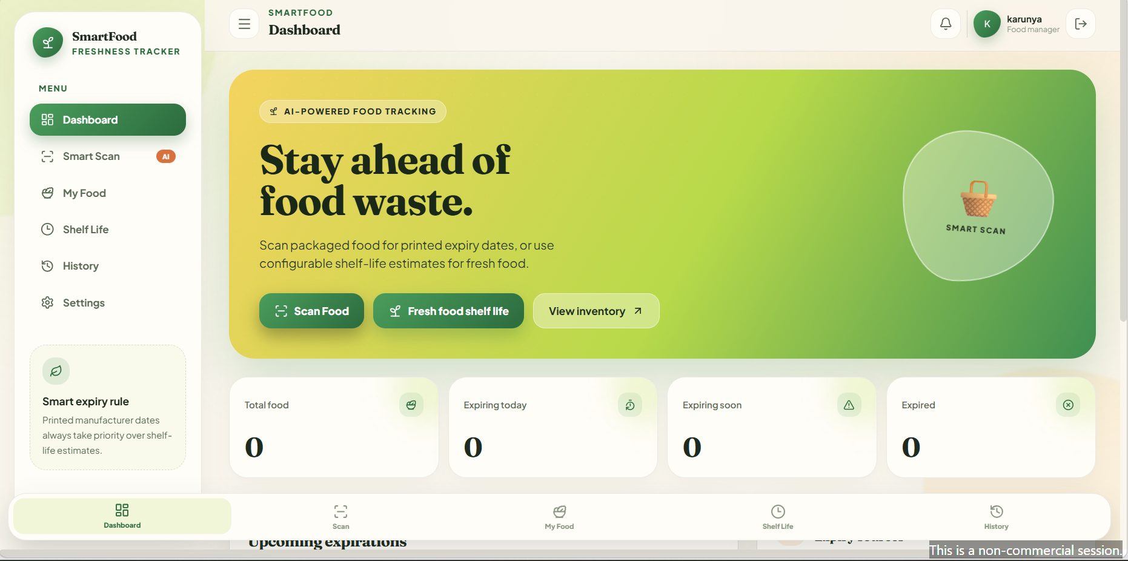
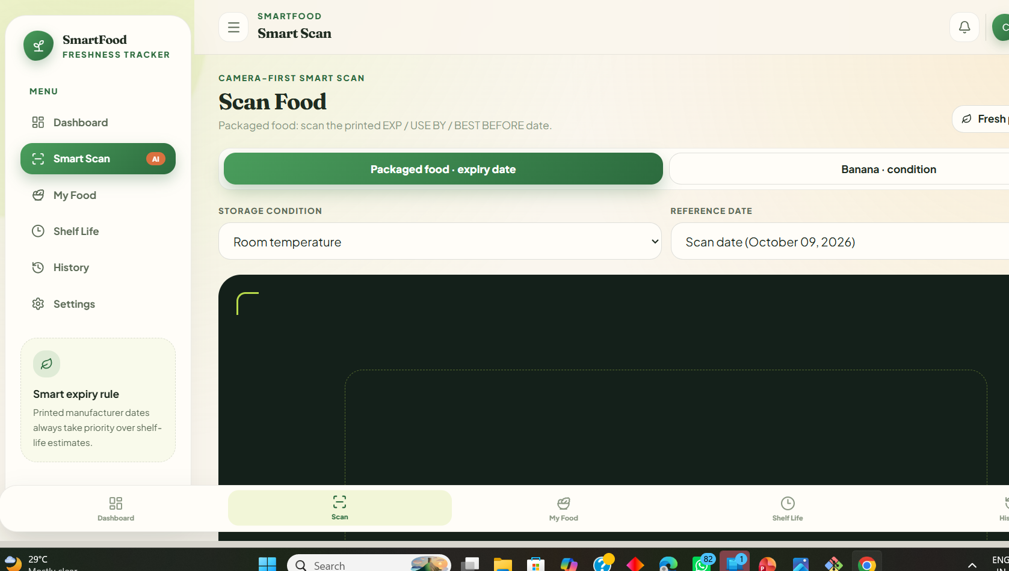
Implementation Screens
14

Slide 15
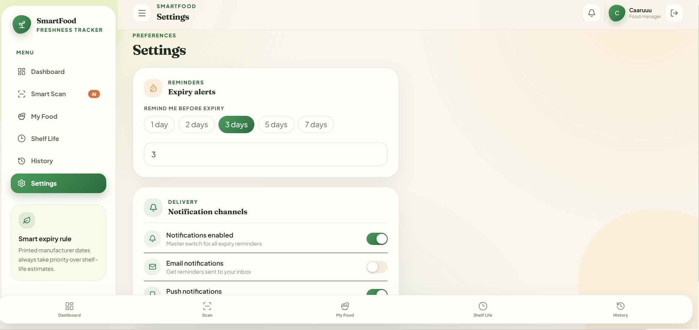
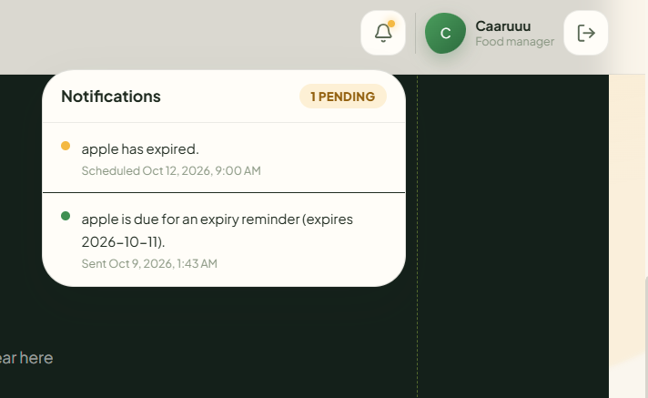
Implementation Screens
15

Slide 16
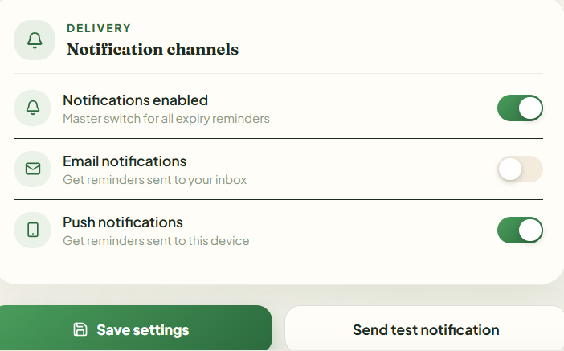
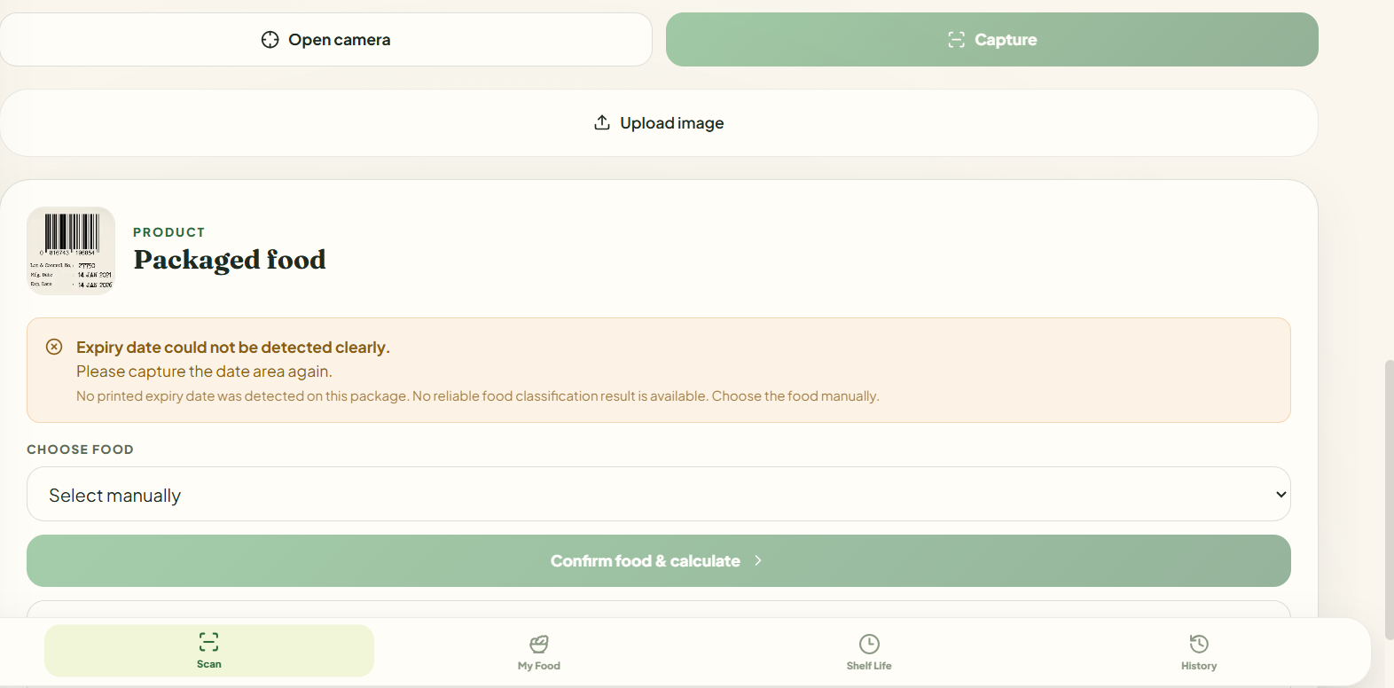
Implementation Screens
16

Slide 17
Testing and Validation
Functional tests
OCR tests
Shelf-life tests
Check login, scanning, date parsing, item saving, inventory views, and settings using test cases.
Compare OCR-extracted dates with known printed dates across clear and difficult images.
Compare estimated expiry dates against the configured category rules and selected storage condition.
Report only results you have measured. The abstract lists provisional metrics (92% accuracy, 94% precision, 90% recall, ~92% F1, and 1.5-day MAE) as illustrative estimates, not validated results.
17

Slide 18
Current Status and Limitations
Confirmed from supplied materials
Limitations to verify / disclose
• Smart Scan interface has packaged-food and banana-condition modes.
• Storage condition and reference date are selectable.
• Settings UI includes reminder lead time and notification preferences.
• Deployment configuration describes React frontend, FastAPI backend, and MongoDB Atlas.
• Deployment notes state AI food recognition is configured in mock mode on the free tier.
• OCR can fail on low-quality or unclear images.
• Uploaded scan images may not persist after a free-service restart.
• Shelf-life estimates are indicative, not food-safety advice.
18

Slide 19
Future Implementation: Automated Expiry Notifications
Automated Scanning: When departmental store staff scan a food product, its product details and expiry date will be recorded in the system.
Mobile Notifications: The system will automatically send notifications to the store manager's mobile phone before the product expires.
Early Alerts: Notifications will be triggered at predefined intervals, such as 7 days, 3 days, and 1 day before expiry.
Inventory Monitoring: The system will continuously monitor registered products and identify items approaching their expiry dates.
Food Waste Reduction: Store staff can take timely action, such as prioritizing sales, applying discounts where appropriate, or removing expired products from sale.
Expected Outcome: A smart inventory monitoring system that helps departmental stores manage expiry dates efficiently, reduce food waste, and improve food safety.
19

Slide 20
Conclusion and Future Enhancements
SmartFood brings expiry-date scanning, shelf-life guidance, inventory tracking, and configurable reminders into one interface.
Conclusion
Future enhancements
The system is designed to reduce manual tracking effort and help users notice food items approaching expiry.
• Improve OCR under difficult lighting and packaging conditions
• Replace mock recognition with a validated trained model
• Persist scan images using object storage
• Evaluate on a labelled dataset and report measured metrics
Thank you • Questions?
20

Slide 21
Thank You
FINAL REVIEW
Questions & Discussion
Food Expiry Detection and Reminder System

